Slide 1
Walmart Customer Segmentation & Insights
Data-Driven Customer Analysis
May 2025

Slide 2

Agenda
Customer Demographic Analysis
Product Analysis
Customer Segmentation
Customer Personas
Actionable Strategies

Slide 3
Executive Summary
25% more likely to be high spenders: 26-35 age group
9% over-represented in high-spending category: Males
88% more likely to be premium shoppers: City B customers
53% higher representation among big spenders: Occupation #5
8% more likely to spend heavily: 3-year city residents
Customer Segment Performance
High Value Customers: Males 26-35 in City B working in Occupation #5
Growth Opportunity: 3-year city residents show increased loyalty patterns
Key Revenue Drive: Focus marketing campaigns on demographic clusters with
highest spending indices

Slide 4
Customer Demographic Analysis
Who Is Our Customer?

Slide 5
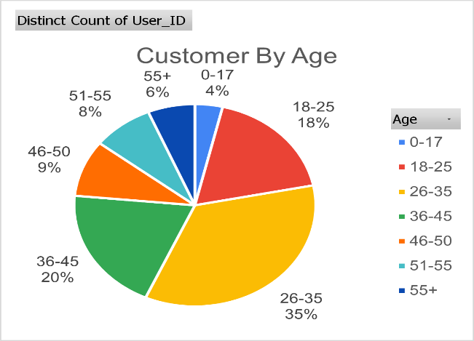
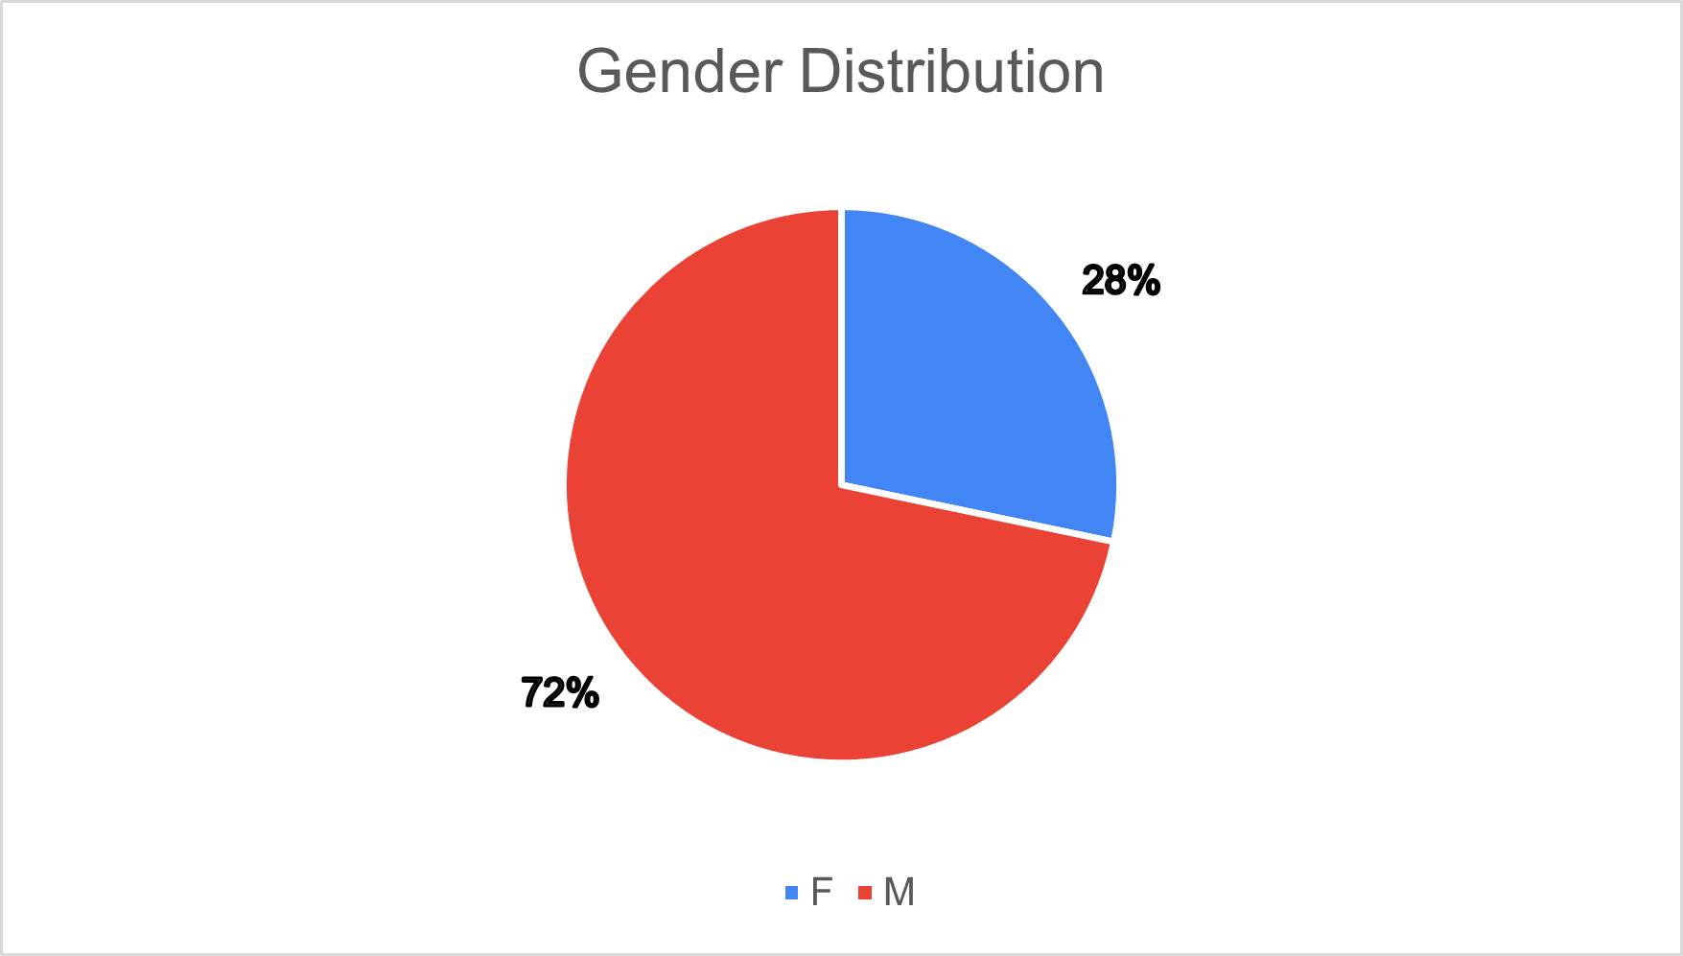
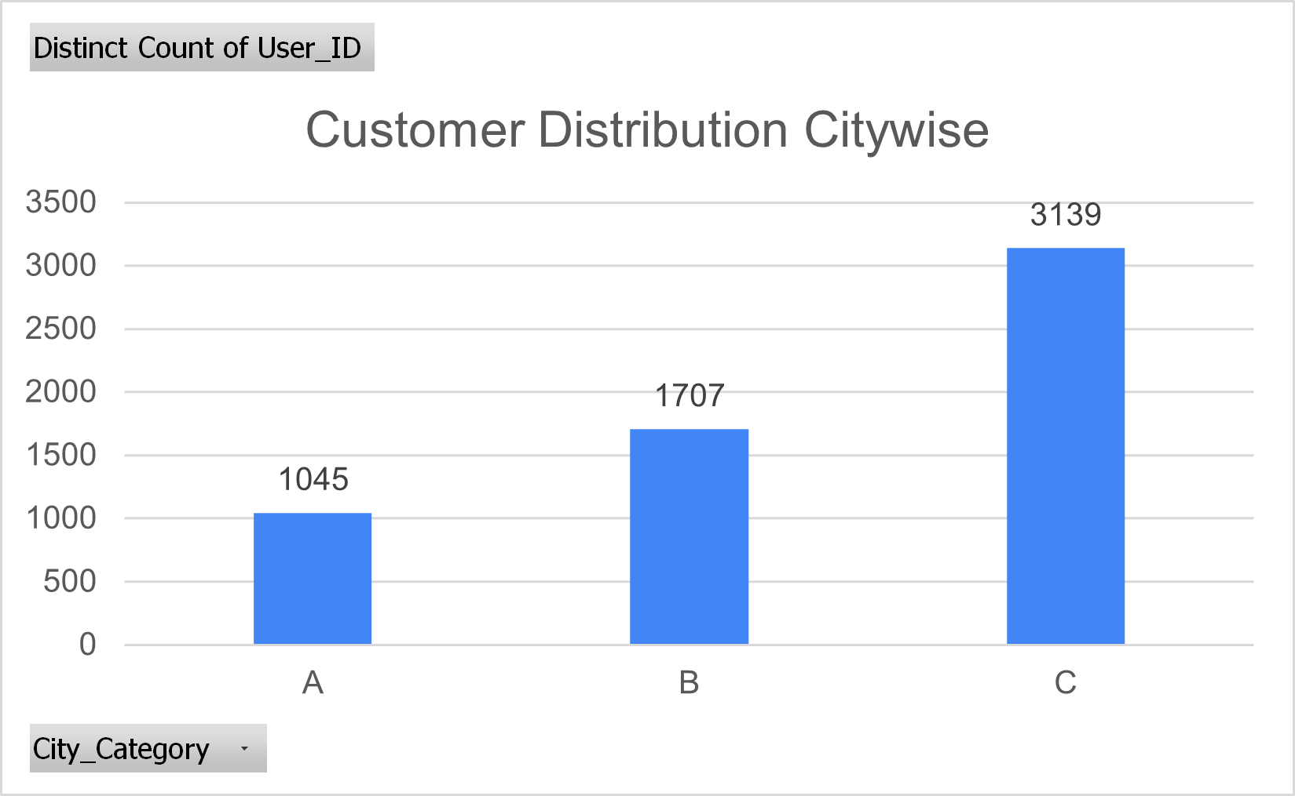
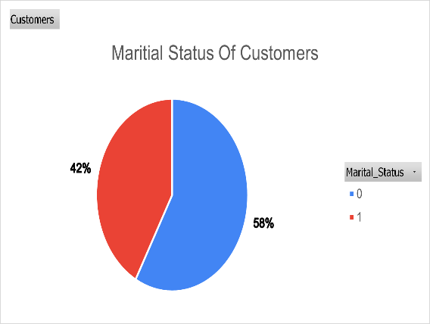
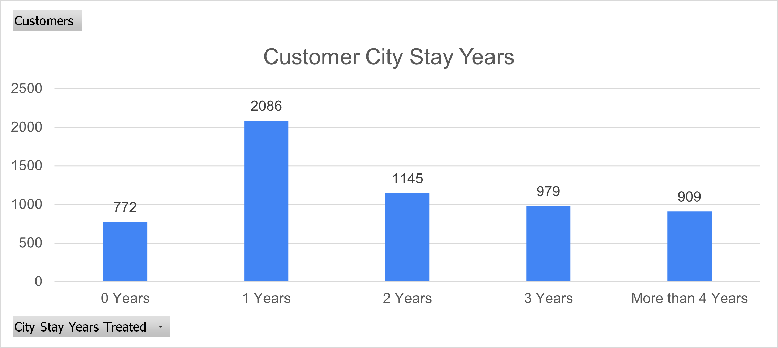
Majority Are Young, Male and New to the City
Findings at a Glance:
Customer Age Distribution
Age: 55% of customers are 26-45 years old Gender: 72% male vs 28% female customer base City: 53% in City C, 29% in City B, 18% in City A
City Stay: 35% are 1-year residents, only 15% stayed 4+ years
Marital Status: 58% single, 42% married
Insights
Focus on male-oriented marketing and store experience Target working-age adults (26-45) as primary demographic
Develop City C-specific strategies to capture majority market
Create programs for new residents who form largest segment
Walmart Customer Segmentation Analysis
Confidential
2 / 3

Slide 6
Product Analysis
What Do They Buy?

Slide 7
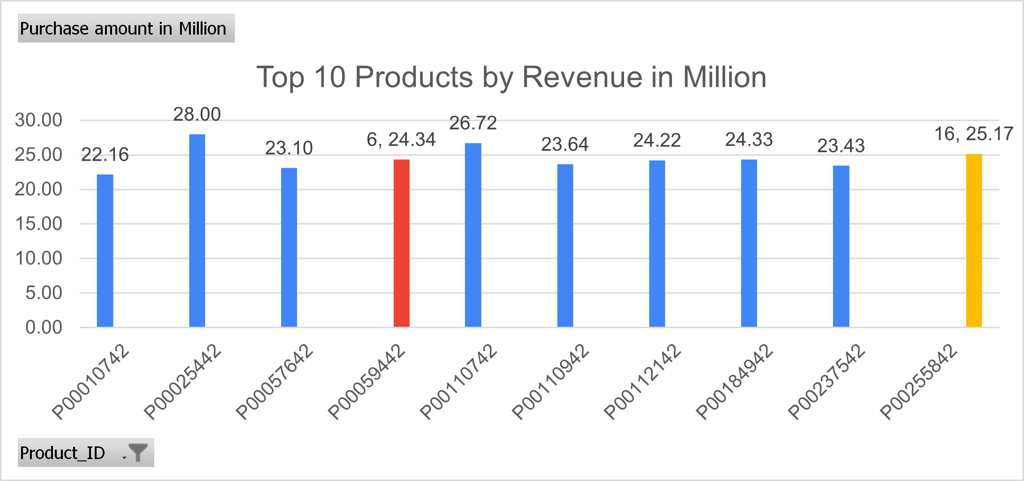
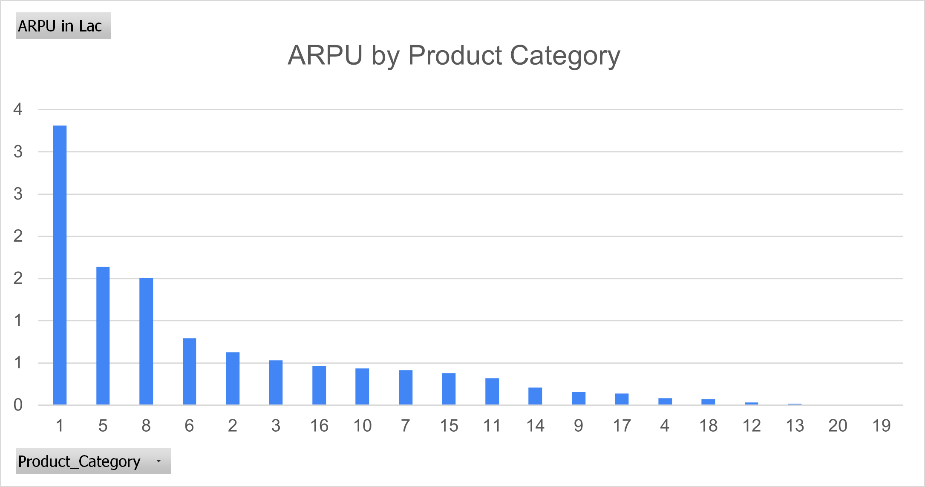
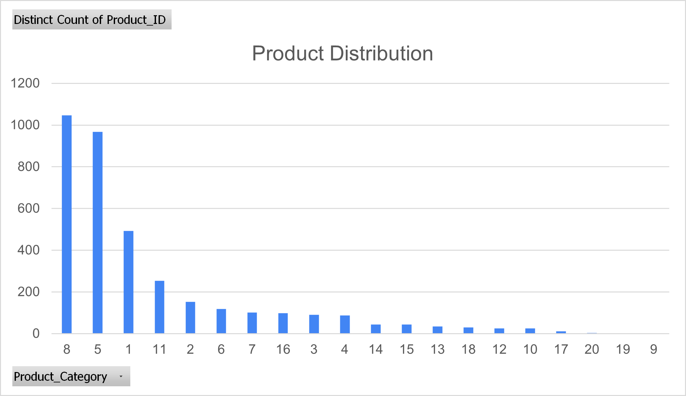
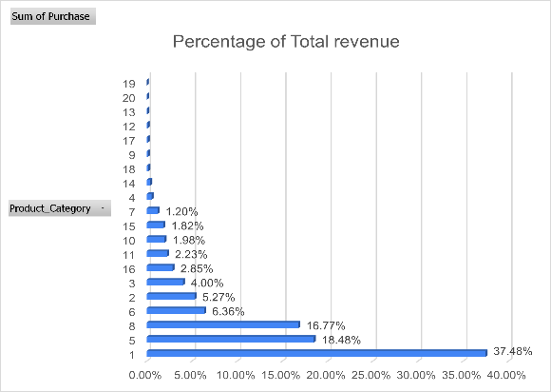
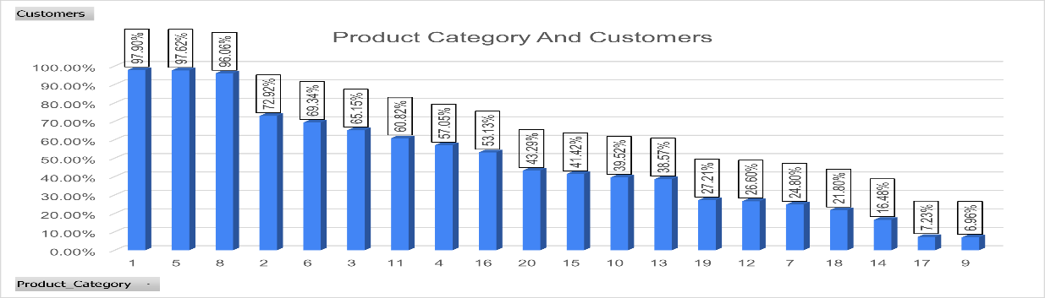
Top 3 Product Categories Drive Over 70% of Revenue
Top Performers Drive Majority Revenue:
Just 3 product categories (1, 5, 8) contribute over 72% of total revenue Category 1 alone accounts for 37.5% – a clear flagship category
ARPU by Product Category
High Reach + High ARPU = Hero Categories:
Categories 1, 5, and 8 have:
Highest customer reach (96%+) Highest ARPU ( 2–3.6L) Strong SKU presence
Product Distribution
Percentage Revenu by Product Category
SKU Optimization
Category 8 has the widest SKU base but slightly lower ARPU than Category 1
Long tail of categories contributes minimal revenue and can be pruned or repositioned
Strategic Focus Areas:
Double down on Categories 1, 5, 8 with promotions, cross-sells & visibility Rationalize low-performing SKUs (e.g., Categories 9, 19, 20)
Explore growth potential in mid-tier ARPU categories with good reach (e.g., Category 2 & 6)
Product Category and Customers
Walmart Customer Segmentation Analysis
Confidential

Slide 8
Customer Segmentation
Who Likes What?

Slide 9
Young Males Are More Likey to Be High Spender
Age Distribution by Spending Category
High Spenders
Low Spenders
•
•
•
Ages 26-35: 1.25x over-represented
Ages 36-45: 1.15x over-represented Ages 18-25: 0.92x under-represented
•
•
•
Ages 55+: 1.38x over-represented
Ages 18-25: 1.17x over-represented Ages 26-35: 0.75x under-represented
Gender & Spending Patterns
Males
1.09x
more likely to be high spenders
Over-indexed in tech products
Higher average basket size
Females
1.20x
more likely to be low spenders
Higher frequency of visits
More small-basket transactions
•
•
•
•

Slide 10
Premium Buyers Cluster Around Categories 9 and 18
Category Performance Index
Category Distribution Across Spending Segments
High Spender Categories
Category | High Spender Index | Mid Spender Index | Low Spender Index | Strategic Focus
Category 9 | 1.10x | 0.97x | 0.93x | Premium Products
Category 18 | 1.13x | 0.98x | 0.89x | Premium Products
Category 5 | 1.03x | 1.05x | 0.92x | Mixed Strategy
Category 19 | 0.42x | 0.62x | 3.96x | Value Campaign
Category 20 | 0.45x | 0.68x | 3.87x | Value Campaign
•
Category 9: 1.10x over- indexed
Category 18: 1.13x over- indexed
•
Low Spender Categories
•
Category 19: 3.96x over- indexed
Category 20: 3.87x over- indexed
•
Index values represent ratio of category presence in each spending segment vs. overall population

Slide 11
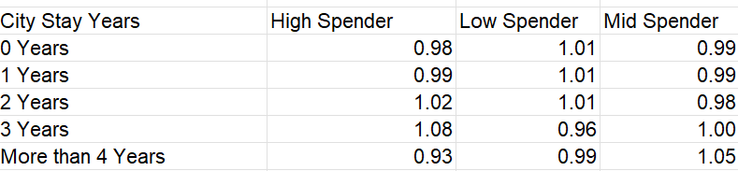
Higher City Tenure More Likely to Spend
City Residence & Spending Patterns
3-Year Residents: 1.08x more likely to be high spenders
4+ Year Residents: 1.05x over-represented in mid- spending
New Arrivals (0-2 years): Slightly over-indexed as low spenders
Spending Index by Years in City
0-1 Years 1-2 Years 3 Years 4+ Years
•
•
•
Loyalty Program Opportunity
Customers in their 3rd year of city residence represent a key transition point to higher spending behaviors. This suggests targeting 2nd-year residents for loyalty program upgrades to accelerate this shift.

Slide 12
Occupation 5 and 20 lead in Premium Spend
Top 5 High-Value Occupations
Occupation #5
Occupation Spending Index Comparison
Occupation | High Spender Index | Mid Spender Index | Low Spender Index
Occupation #5 | 1.53x | 0.86x | 0.61x
Occupation #20 | 1.45x | 0.92x | 0.63x
Occupation #13 | 0.32x | 0.87x | 1.81x
Occupation #10 | 0.36x | 0.91x | 1.73x
Occupation #20
Occupation #2
Occupation #19
Occupation #16
Strategic Targeting Opportunity
Occupations #5, #20, #2, #19, and #16 show high affinity for premium products. Consider occupation-specific marketing campaigns, particularly for Categories 9 & 18.

Slide 13
Customer Personas
How They Behave?

Slide 14
Customer Personas: Meet Our Shoppers
Premium Pete
Value Victoria
Midrange Mike
•
•
•
•
•
•
•
•
•
•
55+ female
City C resident Occupation #8
New to city (0-1 years)
Low to mid-value customer
•
•
46-50 male
Long-term resident (4+ years)
Occupation #12 City A resident
Mid-value customer
26-35 year old male
City B resident Occupation #5 3 years in city
High-value customer
•
•
•
Shopping Habits:
Prefers premium products
Larger basket sizes Shops Categories 9 & 18
Shopping Habits:
Price-sensitive shopper
Frequent small purchases Shops Categories 19 & 20
Shopping Habits:
Mix of premium and value items
Consistent, predictable purchases Loyal to store location
•
•
•
•
•
•
•
•
•

Slide 15
Actionable Strategies
What Can We Do?

Slide 16
4 Actionable Strategies to Boost Revenue
1. Target Premium Products
Focus on males 26-45 in Cities A & B
Enhanced displays for Categories 9 & 18
Create premium bundles for high-value occupations
2. Optimize Value Offerings
Tailor to females 55+ in City C
Expand product assortment in Categories 19 & 20
Price point optimization for value-conscious segments
•
•
•
•
•
•
3. Loyalty Program Redesign
Special focus on 3-year residents
Target transitioning 2-year residents
Personalized rewards based on occupation profiles
4. Category Management
Enhance Categories 9 & 18 for high spenders
Reposition Categories 19 & 20 for value perception
Cross-merchandise between spending segment categories
•
•
•
•
•
•

Slide 17
Questions?
Thank You
Walmart Customer Segmentation & Insights
May 2025

